Slide 1
What is Artificial Intelligence?
By which we can create intelligent machines which can behave like a human, think like humans, and able to make decisions.
Artificial Intelligence exists when a machine can have human based skills such as learning, reasoning, and solving problems.

Slide 2
Why Artificial Intelligence?
With the help of AI, you can create such software or devices which can solve real-world problems very easily and with accuracy such as health issues, marketing, traffic issues, etc.
With the help of AI, you can create your personal virtual Assistant, such as Google Assistant, etc.
With the help of AI, you can build such Robots which can work in an environment where survival of humans can be at risk.
AI opens a path for other new technologies, new devices, and new Opportunities.

Slide 3
Goals of Artificial Intelligence
Replicate human intelligence
Solve Knowledge-intensive tasks
An intelligent connection of perception and action
Building a machine which can perform tasks that requires human intelligence.
Creating some system which can exhibit intelligent behavior, learn new things by itself, demonstrate, explain, and can advise to its user.

Slide 4
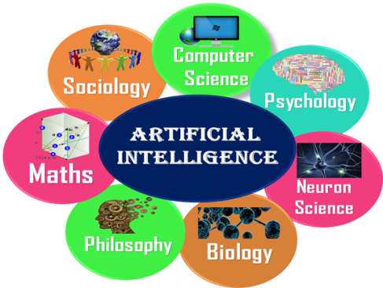
What Comprises to Artificial Intelligence

Slide 5
Advantages of Artificial Intelligence
High Accuracy with less errors: AI machines or systems are prone to less errors and high accuracy as it takes decisions as per pre-experience or information.
High-Speed: AI systems can be of very high-speed and fast-decision making
High reliability: AI machines are highly reliable and can perform the same action multiple times with high accuracy.
Useful for risky areas: such as defusing a bomb, exploring the ocean floor, where to employ a human can be risky.
Digital Assistant: such as AI technology is currently used by various E-commerce websites to show the products as per customer requirement.
Useful as a public utility: such as a self-driving car which can make our journey safer and hassle-free, facial recognition for security purpose, Natural language processing to communicate with the human in human-language, etc.

Slide 6
Disadvantages of Artificial Intelligence
High Cost: The hardware and software requirement of AI is very costly as it requires lots of maintenance to meet current world requirements.
Can't think out of the box: Even we are making smarter machines with AI, but still they cannot work out of the box, as the robot will only do that work for which they are trained, or programmed.
No feelings and emotions: Still it does not have the feeling so it cannot make any kind of emotional attachment with human, and may sometime be harmful for users if the proper care is not taken.
Increase dependency on machines: With the increment of technology, people are getting more dependent on devices and hence they are losing their mental capabilities.
No Original Creativity: As humans are so creative and can imagine some new ideas but still AI machines cannot beat this power of human intelligence and cannot be creative and imaginative.

Slide 7
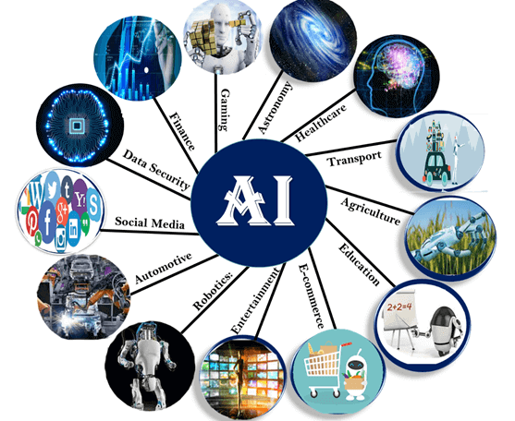
Application of AI

Slide 8
Types of Artificial Intelligence
There are mainly two types of main categorization which are
1. Based on capabilities
2. Based on functionally

Slide 9
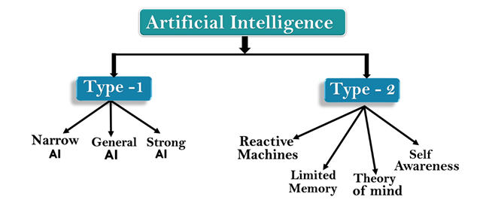

Slide 10
1: Based on Capabilities
Weak AI or Narrow AI:
Narrow AI cannot perform beyond its field or limitations, as it is only trained for one specific task. Hence it is also termed as weak AI. Narrow AI can fail in unpredictable ways if it goes beyond its limits.
Apple Siriis a good example of Narrow AI, but it operates with a limited pre-defined range of functions.
Some Examples of Narrow AI are playing chess, purchasing suggestions on e-commerce site, self-driving cars, speech recognition, and image recognition.

Slide 11
2. General AI:
The idea behind the general AI to make such a system which could be smarter and think like a human by its own.
Currently, there is no such system exist which could come under general AI and can perform any task as perfect as a human.
The worldwide researchers are now focused on developing machines with General AI.

Slide 12
3. Super AI:
Super AI is a level of Intelligence of Systems at which machines could surpass human intelligence, and can perform any task better than human with cognitive properties. It is an outcome of general AI.
Some key characteristics of strong AI include capability include the ability to think, to reason, solve the puzzle, make judgments, plan, learn, and communicate by its own.
Super AI is still a hypothetical concept of Artificial Intelligence. Development of such systems in real is still world changing task.

Slide 13
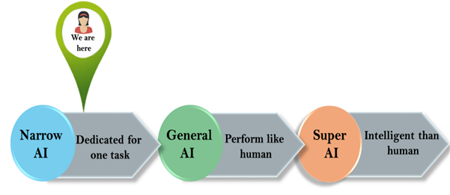

Slide 14
2: Based on functionality
Reactive Machines
Such AI systems do not store memories or past experiences for future actions.
These machines only focus on current scenarios and react on it as per possible best action.
2. Limited Memory
These machines can use stored data for a limited time period only.
Self-driving cars are one of the best examples of Limited Memory systems. These cars can store recent speed of nearby cars, the distance of other cars, speed limit, and other information to navigate the road.

Slide 15
3. Theory of Mind
Theory of Mind AI should understand the human emotions, people, beliefs, and be able to interact socially like humans.
This type of AI machines are still not developed, but researchers are going on.
4. Self-Awareness
Self-awareness AI is the future of Artificial Intelligence. These machines will be super intelligent, and will have their own consciousness, sentiments, and self-awareness.
These machines will be smarter than human mind.
Self-Awareness AI does not exist in reality still and it is a hypothetical concept.

